Slide 1

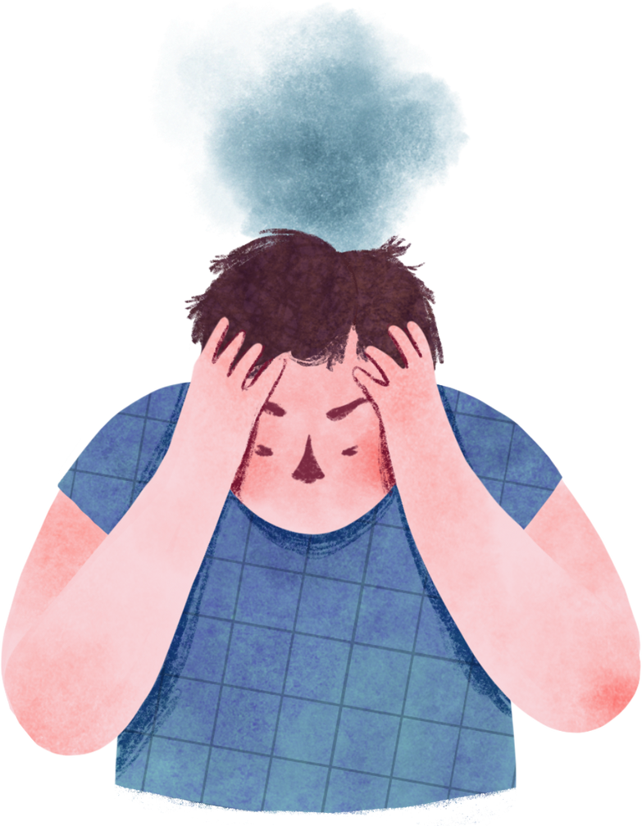

HUMAN STRESS DETECTION AND
PREDICTION USING ANN
TEAM - 2
TEAM MEMBERS:
ABHISHEK SRIRAM (TEAM LEADER)
JYOSNA
SWAPNA
SIDDHI
ANUSHRI

Slide 2


CONTENTS
01 - INTRODUCTION
02 - PROBLEM STATEMENT
03 - ABOUT PARAMETERS
04 - MILESTONE - 1 : DATA PREPROCESSING AND VISUALIZATION
05 - MILESTONE - 2 : MODEL ARCHITECTURE
06 - MILESTONE - 3 : MODEL TRAINING AND EVALUATION
07 - MILESTONE - 4 : MODEL DEPLOYMENT
08 - DATABASE INTEGRATION
09 - HOME PAGE
10 - ABOUT PAGE
11 - SIGNUP PAGE
12 - LOGIN PAGE
13 - DATA ENTRY PAGE
14 - RESULT PAGE
15 - CONCLUSION

Slide 3

01 - INTRODUCTION
Human stress is the body's response to challenging or demanding situations, activating a range of physical and mental reactions aimed at coping with perceived threats.
Stress can influence focus and performance. chronic stress can lead to negative effects on physical and mental health, including anxiety, high blood pressure, sleep disorders, and weakened immunity. Identifying and managing stress is essential for maintaining overall well-being and preventing long-term health issues.

Slide 4
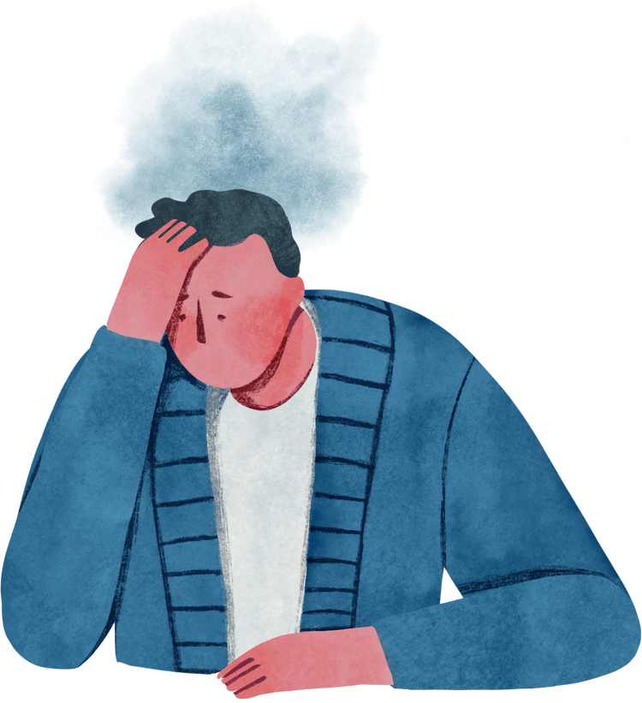
02 - PROBLEM STATEMENT
This project aims to build a system that detects human stress levels during sleep using physiological data. An Artificial Neural Network (ANN) is trained to classify sleep data as "Stressed" or "Not Stressed”.

Slide 5

03 - ABOUT PARAMETERS
SNORING RATE
RESPIRATORY RATE
BODY TEMPERATURE
LIMB MOVEMENT
BLOOD OXYGEN
EYE MOVEMENT
SLEEP HOURS
HEART RATE

Slide 6
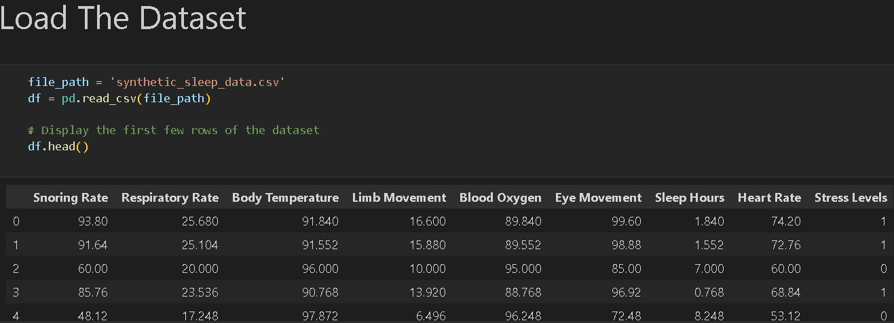
04 - MILESTONE - 1 : DATA PREPROCESSING AND VISUALIZATION
1) DATA PREPROCESSING:
1.1) LOADED THE DATASET AND FOUND IT’S SIZE

Slide 7
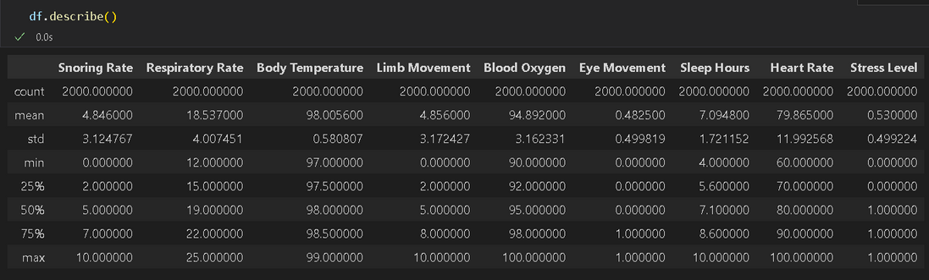
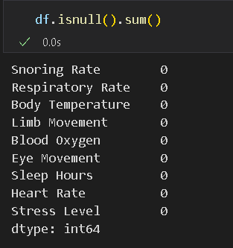
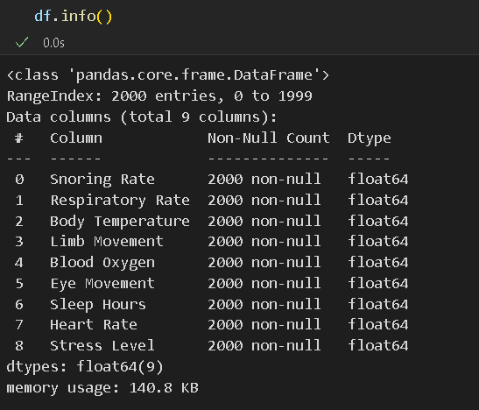
1.2) OBTAINED FIVE POINT SUMMARY
OF THE NUMERICAL FEATURES
1.4) CHECKED FOR MISSING/NUULL VALUES
1.3) OBTAINED INFO ABOUT THE DATATYPE OF THE FEATURES

Slide 8
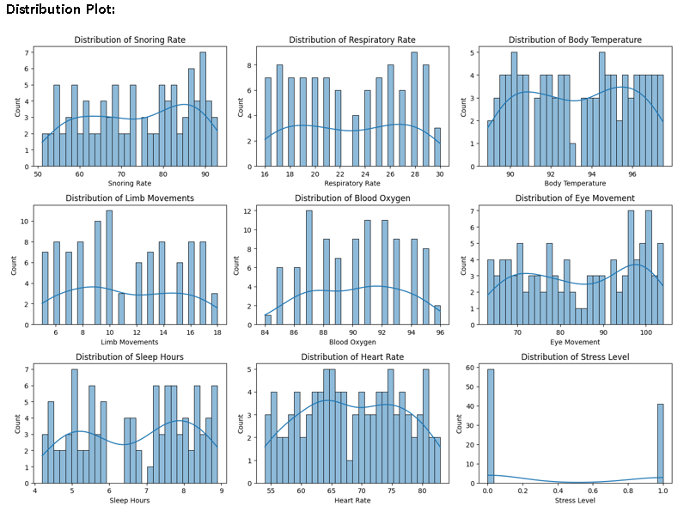
2) DATA VISUALIZATION:

Slide 9
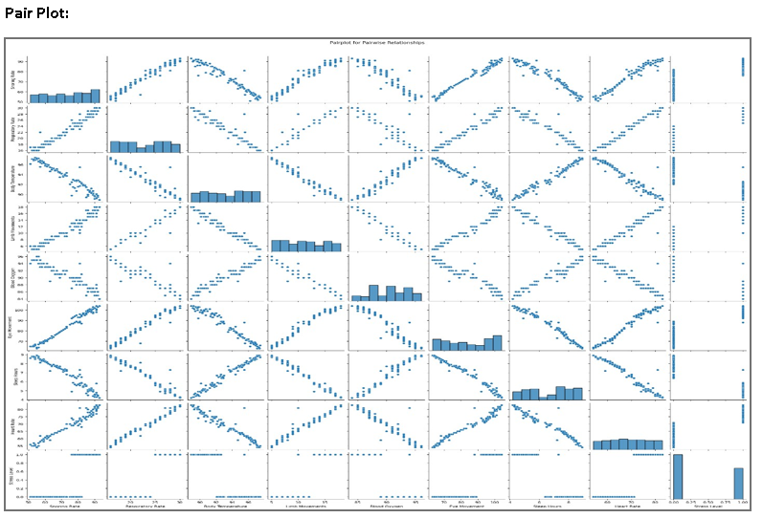

Slide 10
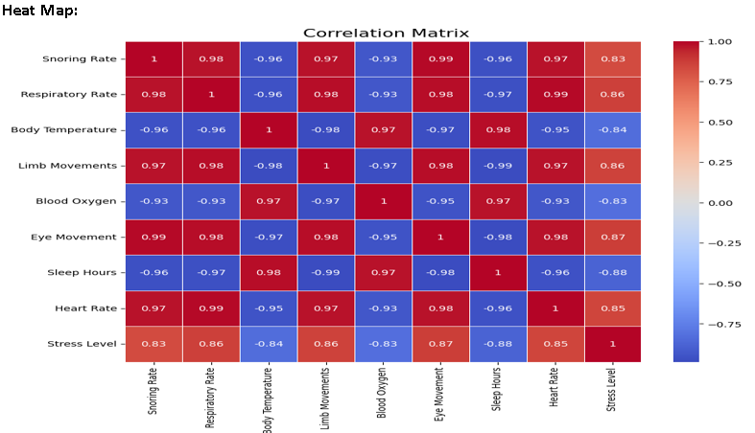

Slide 11
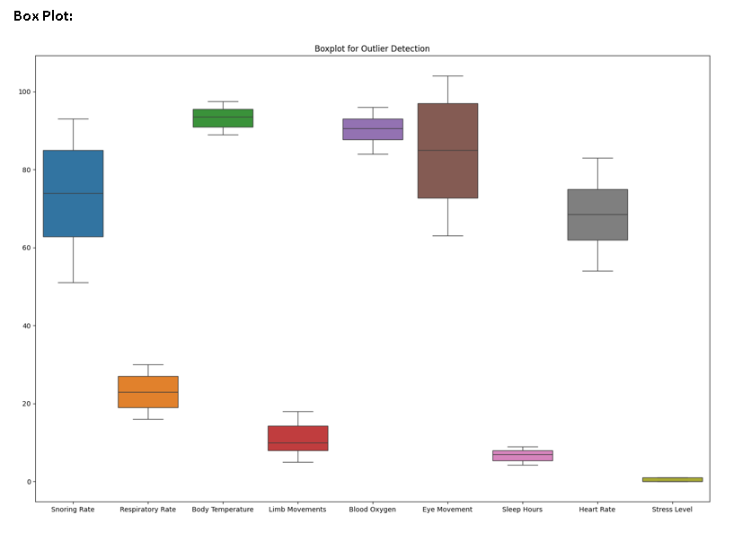

Slide 12
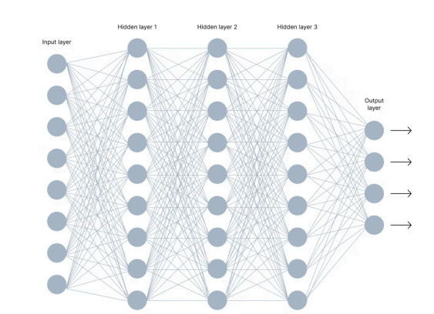
05 - MILESTONE - 2 : MODEL ARCHITECTURE

Slide 13
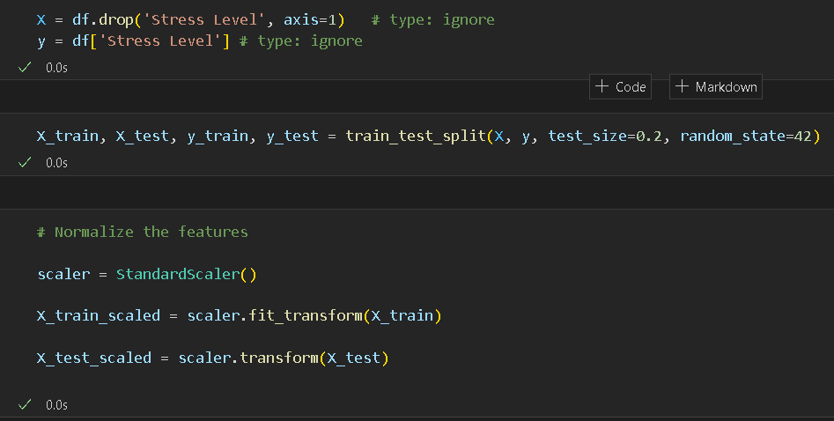

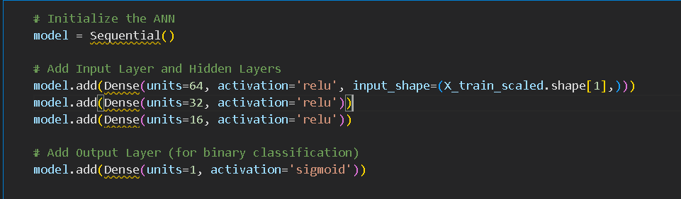
06 - MILESTONE - 3 : MODEL TRAINING AND EVALUATION
1) MODEL TRAINING:

Slide 14
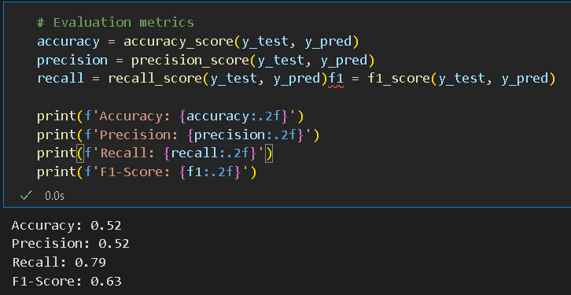
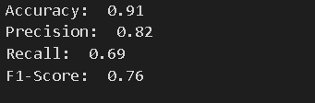
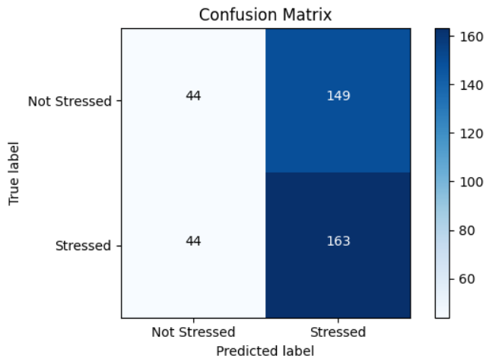
2) MODEL EVALUATION:

Slide 15
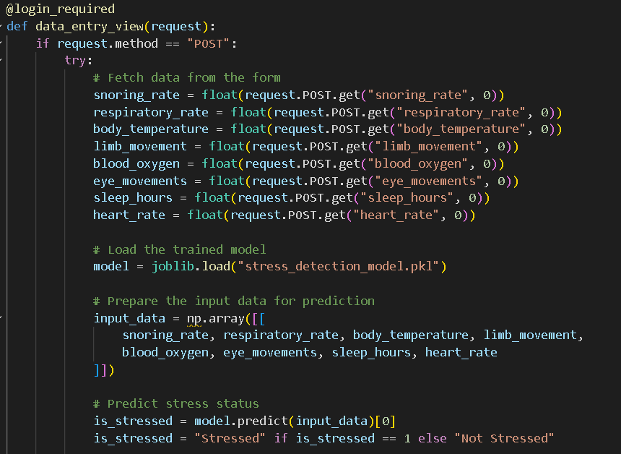
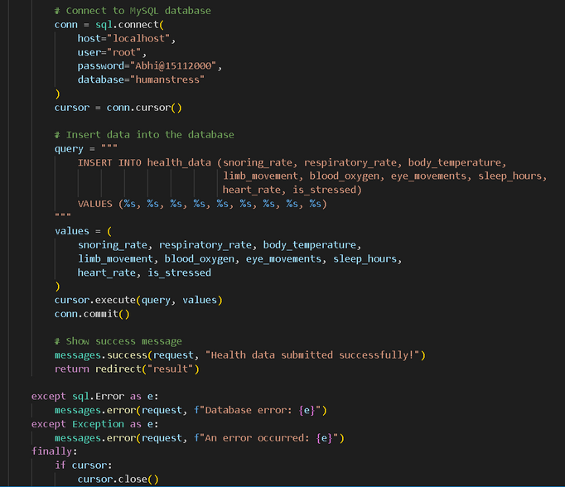
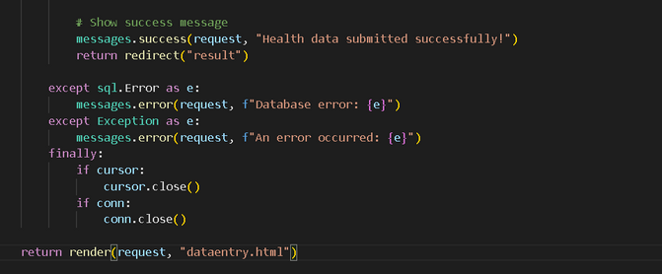
07 - MILESTONE - 4 : MODEL DEPLOYMENT

Slide 16
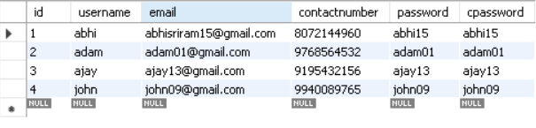
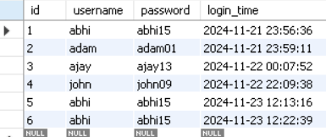
08 DATABASE INTEGRATION
1) SIGNUP TABLE:
2) LOGIN TABLE:

Slide 17
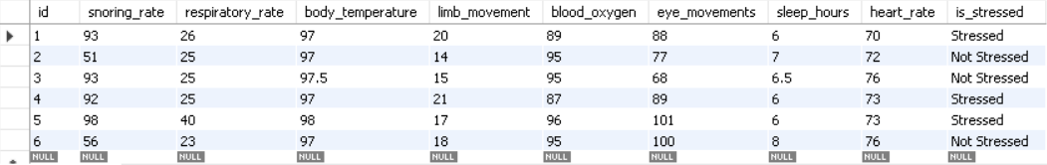
3) HEALTH DATA TABLE:

Slide 18
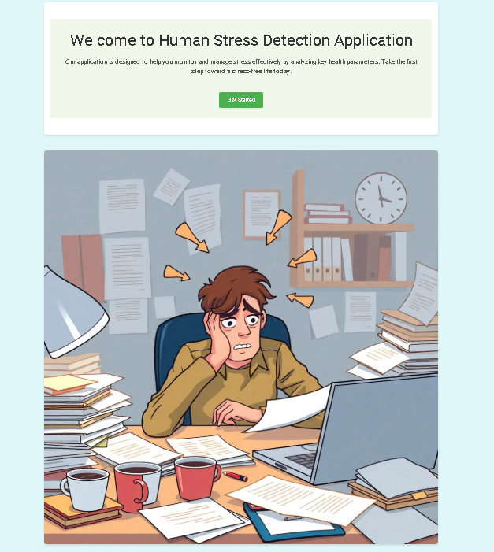
09 - HOME PAGE

Slide 19
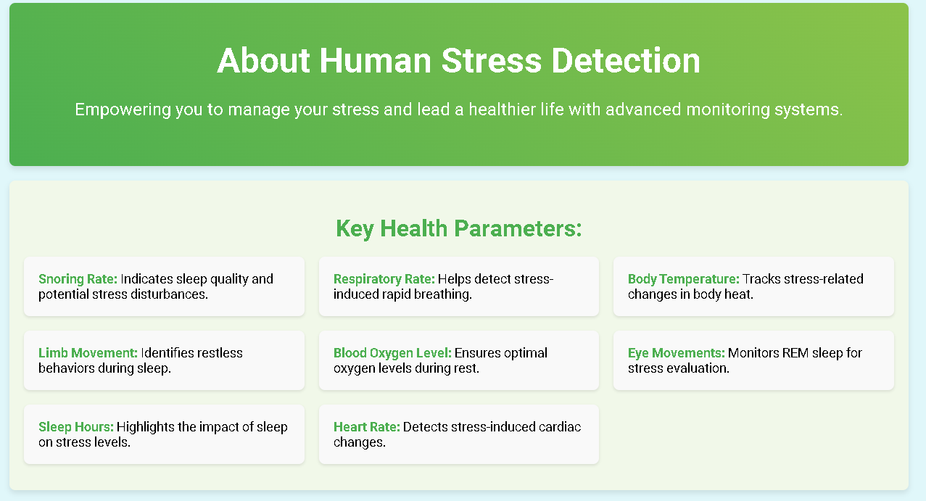
10 - ABOUT PAGE

Slide 20
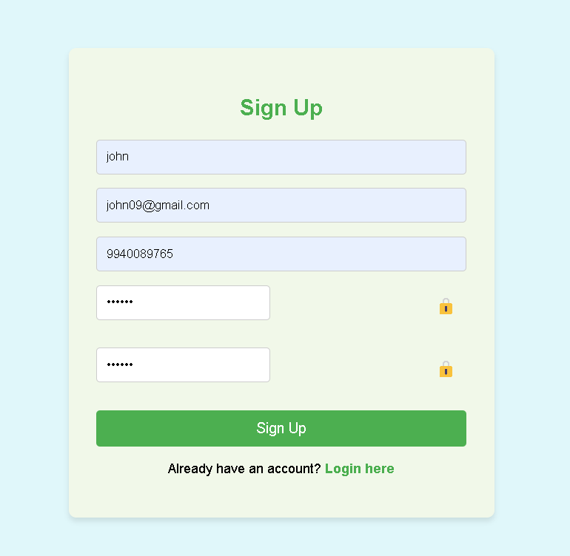
11 - SIGNUP PAGE

Slide 21
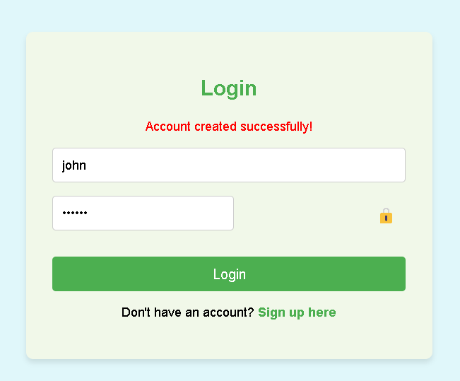
12 - LOGIN PAGE

Slide 22
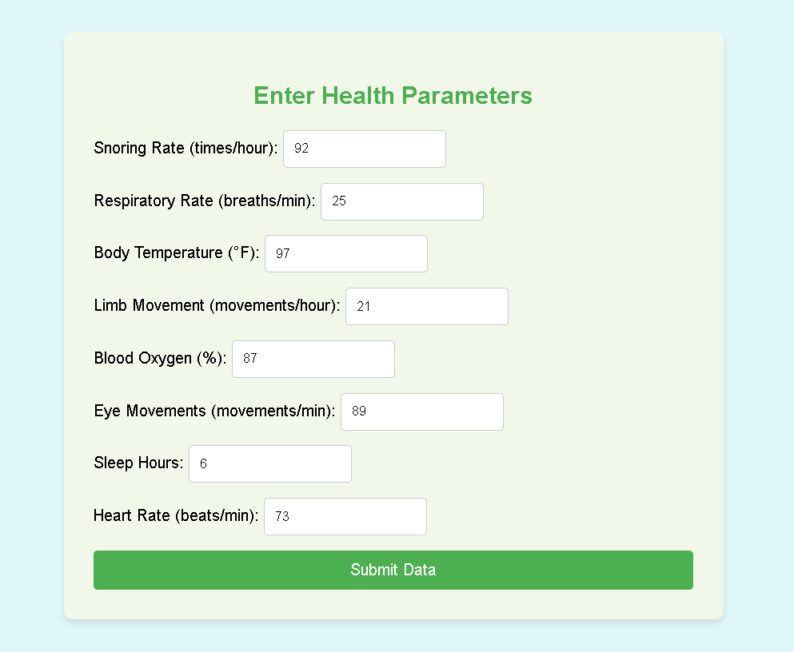
13 - DATA ENTRY PAGE

Slide 23

14 - RESULT PAGE

Slide 24
15 - CONCLUSION
Stress detection systems offer insights into stress levels and their effects on health, especially during critical recovery periods like sleep. With accurate stress monitoring, individuals can take proactive steps to improve their well-being, reduce health risks associated with chronic stress, and enhance overall quality of life.

Slide 25
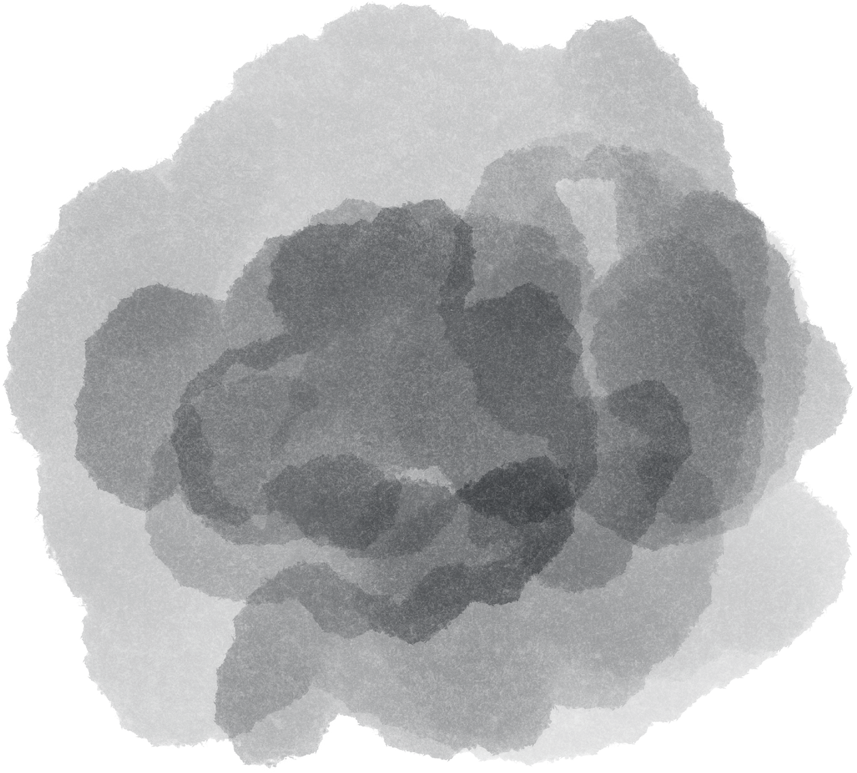
THANK YOU

